Slide 1

Statistical Analysis for Next-Generation Sequencing data in Family-based designs
Introduction
An overview of rare-variant analysis
Family-based rare-variant association test
Family-based rare-variant association test for X-linked genes
Summary and Conclusion
서울대학교 생물정보학 협동과정
생물정보통계연구실(BIBS) 최성경

Slide 2
ntroduction
I
The background on genetic association studies
Missing heritability
Rare variant
X-chromosome in association studies

Slide 3
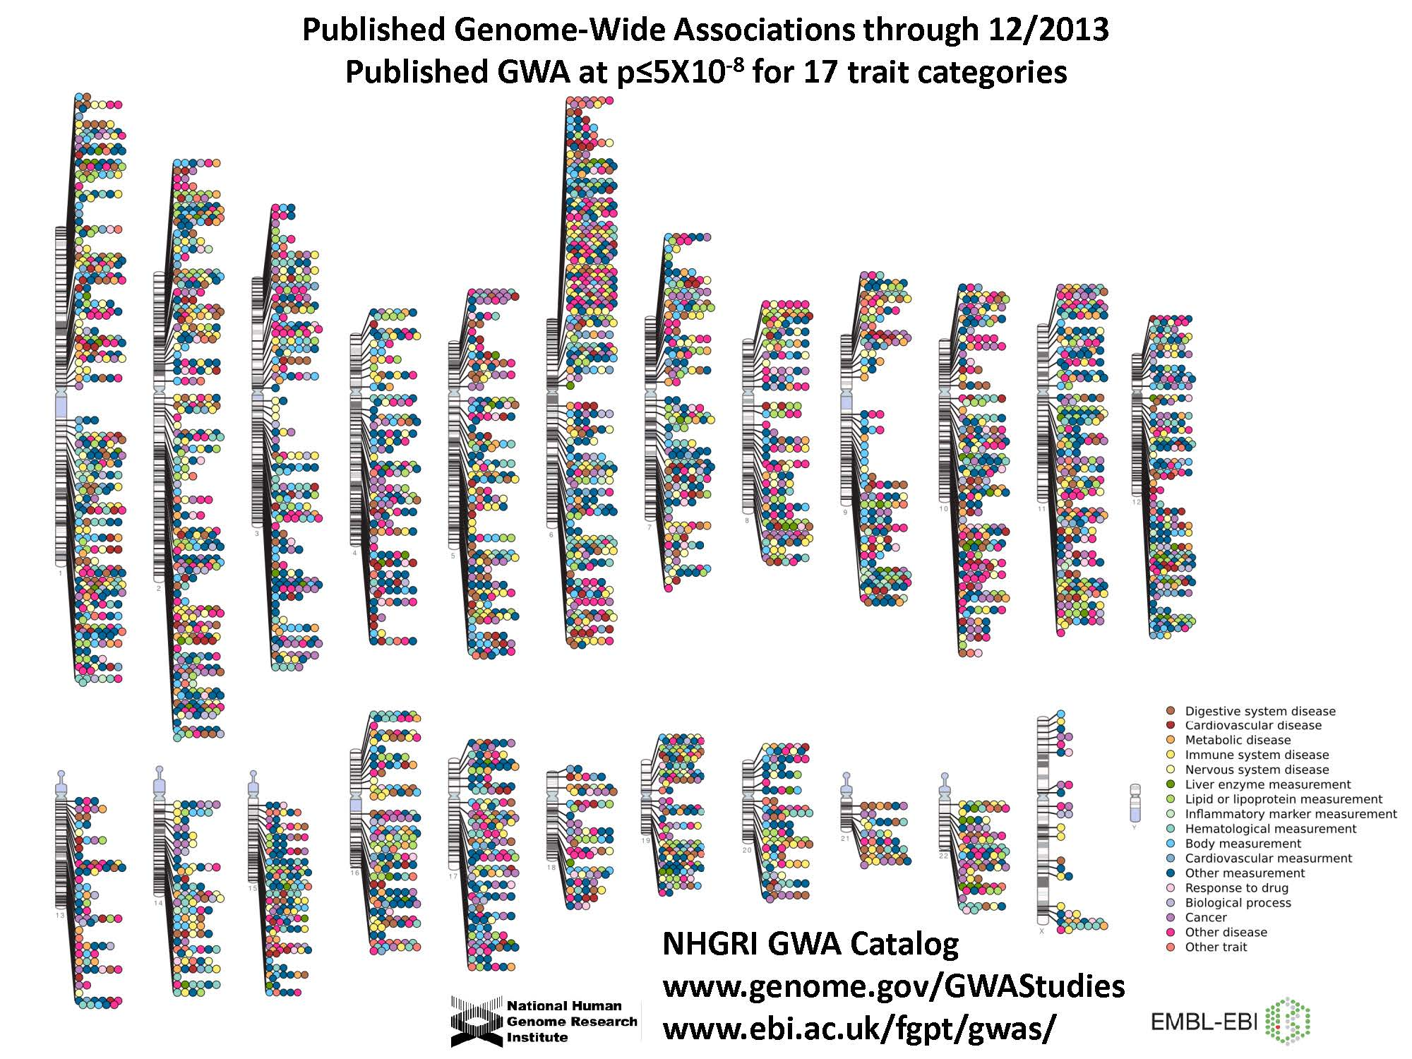
GWAS catalogs
Introduction
An overview of rare-variant analysis
Family-based rare-variant association test
Family-based rare-variant association test for X-linked genes
Summary and Conclusion
The background on genetic association studies
Missing heritability
Rare variant
X-chromosome in association studies

Slide 4

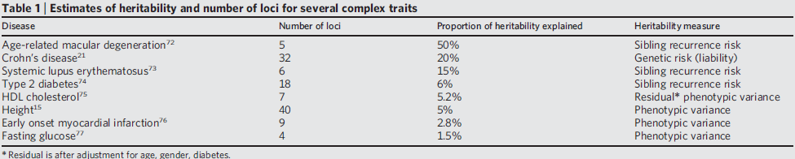
Missing heritability
Introduction
An overview of rare-variant analysis
Family-based rare-variant association test
Family-based rare-variant association test for X-linked genes
Summary and Conclusion
The background on genetic association studies
Missing heritability
Rare variant
X-chromosome in association studies
Manolio et al, Nature 2009

Slide 5
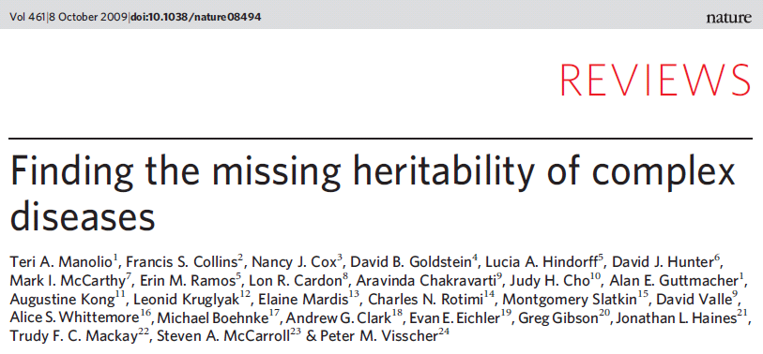
Missing heritability
Introduction
An overview of rare-variant analysis
Family-based rare-variant association test
Family-based rare-variant association test for X-linked genes
Summary and Conclusion
The background on genetic association studies
Missing heritability
Rare variant
X-chromosome in association studies
Possible explanations
Rare variants
Gene × gene, Gene × environment Interaction
Overestimation of heritability

Slide 6
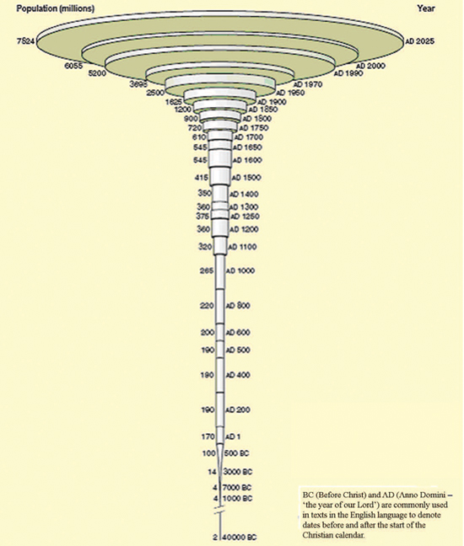
Why rare variant?
Introduction
An overview of rare-variant analysis
Family-based rare-variant association test
Family-based rare-variant association test for X-linked genes
Summary and Conclusion
The background on genetic association studies
Missing heritability
Rare variant
X-chromosome in association studies
Human population growth rising steeply
McEvedy and Jones, 1978
Bansal et al Nat Rev Genet, 2010

Slide 7
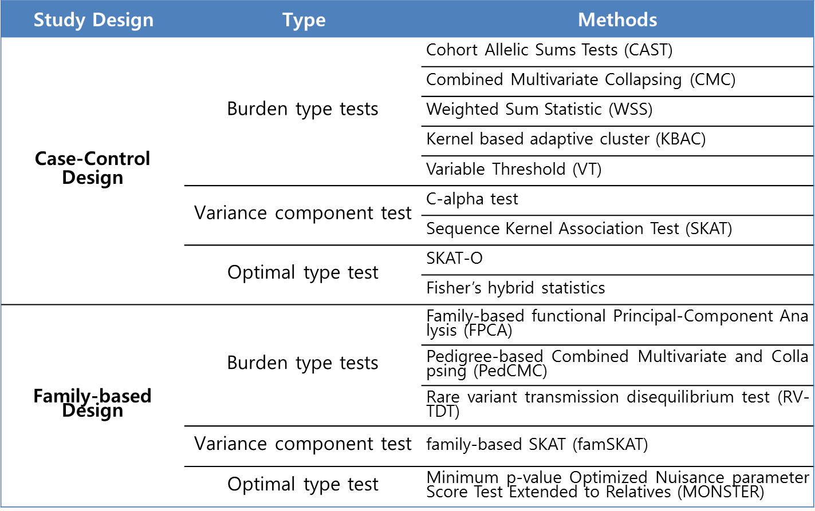
Recent improvements
Introduction
An overview of rare-variant analysis
Family-based rare-variant association test
Family-based rare-variant association test for X-linked genes
Summary and Conclusion
The background on genetic association studies
Missing heritability
Rare variant
X-chromosome in association studies

Slide 8
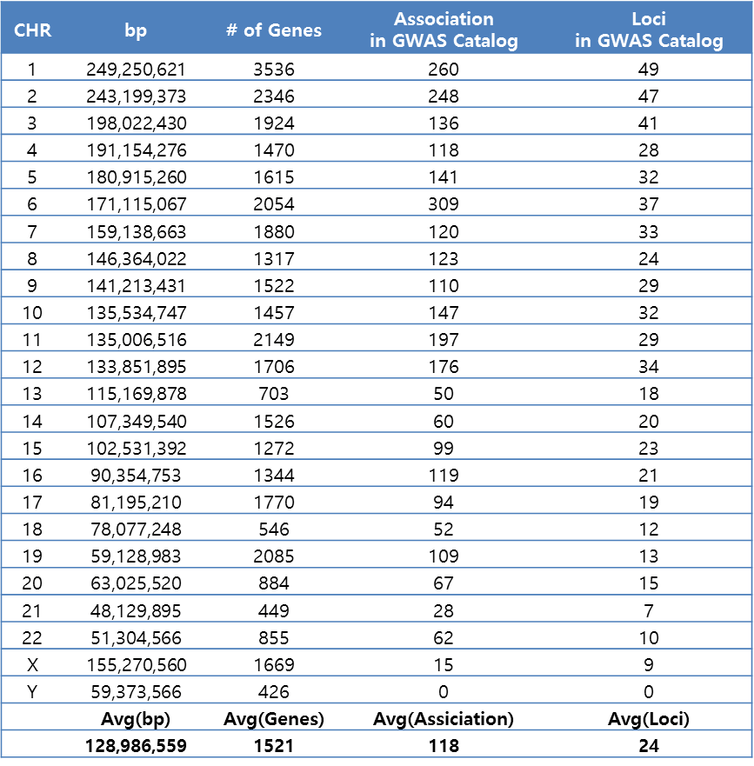
X Chromosome Results in the GWAS Catalog
Introduction
An overview of rare-variant analysis
Family-based rare-variant association test
Family-based rare-variant association test for X-linked genes
Summary and Conclusion
The background on genetic association studies
Missing heritability
Rare variant
X-chromosome in association studies
GWAS have identified more than 2,800 associations for nearly 300 traits in more than 1,400 papers, yet only 15 such associations have been reported on the X chromosome
Why are so few hits reported on the X chromosome?
Table 1. A Comparison of Autosomal Chromosomes
to the X and Y Chromosomes
Wise, A. L., Gyi, L., & Manolio, T. A., 2013

Slide 9
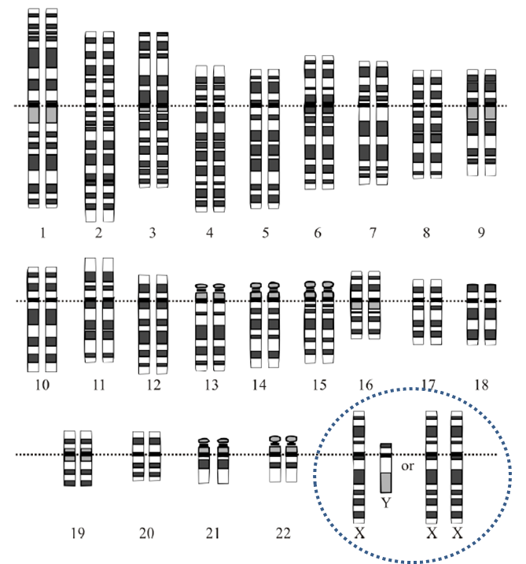
The features of X Chromosome
Introduction
An overview of rare-variant analysis
Family-based rare-variant association test
Family-based rare-variant association test for X-linked genes
Summary and Conclusion
The background on genetic association studies
Missing heritability
Rare variant
X-chromosome in association studies
XY in males and XX in females
males have one allele
females have two alleles
Pseudoautosomal Regions (PARs)
Homologues DNA sequence on X and Y chromosomes in male, and on both X’s in female.
X-chromosome inactivation (XCI) in female
Dosage compensation by suppressing on X-chromosome in females to equalize the dosage effect in males.
escaped XCI or skewed XCI
Source: “Human Karyotype” @ http://www.biologycorner.com/APbiology/inheritance/10‐1_meiosis.html

Slide 10
Recent improvements
Introduction
An overview of rare-variant analysis
Family-based rare-variant association test
Family-based rare-variant association test for X-linked genes
Summary and Conclusion
The background on genetic association studies
Missing heritability
Rare variant
X-chromosome in association studies
Study Design | Type | Methods
Case-Control Design | Burden type tests | Burden test to analyze X-chromosome variants
 | Variance component test | SKAT to analyze X-chromosome variants
 | Optimal type test | SKAT-O to analyze X-chromosome variants
Family-based Design | Burden type tests | PedCMC-Burden for the X chromosome
 | Variance component test | PedCMC-Kernel for the X chromosome

Slide 11
n overview of rare-variant analysis
A
Review of rare-variants methods
Burden-type methods
Variance component-type methods
Optimal-type methods
Purpose and novelty of this study

Slide 12
Burden-type methods
Introduction
An overview of rare-variant analysis
Family-based rare-variant association test
Family-based rare-variant association test for X-linked genes
Summary and Conclusion
Review of rare-variants methods
Purpose and novelty of this study
Case-Control Design
Cohort Allelic Sums Tests (CAST)
Combined Multivariate Collapsing (CMC)
Weighted Sum Statistic (WSS)
Kernel based adaptive cluster (KBAC)
Variable Threshold (VT)
Burden test to analyze X-chromosome variants
Family-based Design
Family-based functional Principal-Component Analysis (FPCA)
Pedigree-based Combined Multivariate and Collapsing (PedCMC)
Rare variant transmission disequilibrium test (RV-TDT)
PedCMC-Burden for the X chromosome

Slide 13
Variance component-type methods
Introduction
An overview of rare-variant analysis
Family-based rare-variant association test
Family-based rare-variant association test for X-linked genes
Summary and Conclusion
Review of rare-variants methods
Purpose and novelty of this study
Case-Control Design
C-alpha test
Sequence Kernel Association Test (SKAT)
SKAT to analyze X-chromosome variants
Family-based Design
family-based SKAT (famSKAT)
PedCMC-Kernel for the X chromosome

Slide 14
Optimal-type methods
Introduction
An overview of rare-variant analysis
Family-based rare-variant association test
Family-based rare-variant association test for X-linked genes
Summary and Conclusion
Review of rare-variants methods
Purpose and novelty of this study
Case-Control Design
SKAT-O
Fisher’s hybrid statistics
SKAT-O to analyze X-chromosome variants
Family-based Design
Minimum p-value Optimized Nuisance parameter Score Test Extended to Relatives (MONSTER)

Slide 15
Limitations of previous approaches
Introduction
An overview of rare-variant analysis
Family-based rare-variant association test
Family-based rare-variant association test for X-linked genes
Summary and Conclusion
Review of rare-variants methods
Purpose and novelty of this study
The burden-type method
not account for covariates
power of burden test depend on number of causal/non-causal variants
the burden test is most statistically efficient when most of the rare alleles have similar effects on the disease
Permutation is computationally expensive
The variance component-type method
more powerful when the existence of both deleterious and protective variants are causal variants
Permutation is computationally expensive
The optimal-type method
the potential loss of statistical power by confounding effect, such as population substructures
X-Chromosome method
most cannot account for biologically plausible models, such as skewed XCI
not yet develop the optimal-type method in family-based design

Slide 16
Purpose and novelty of this study
Introduction
An overview of rare-variant analysis
Family-based rare-variant association test
Family-based rare-variant association test for X-linked genes
Summary and Conclusion
Review of rare-variants methods
Purpose and novelty of this study
In chapter 3, the proposed method (FARVAT)
could be a burden test or a variance component test, and could be extended to the SKAT-O-type statistic depending on the choice of working matrix.
could be provided robustness under the presence of the population substructure by using the estimated genetic relationship matrix.
be implemented with C++ and is computationally efficient for the analysis of rare variants with extended families.
In chapter 4, The proposed method (FARVATX)
could be applicable to various biological models such as random X chromosome inactivation (XCI), escaped XCI (E-XCI), and skewed XCI (S-XCI).
could be robustness in both the absence and presence of population substructure.
could be a robust choice for various biological processes by using extended Fisher’s method.

Slide 17
amily-based rare-variant association test
F
Methods
Notation
Family-based rare-variant association test
Simulation study
The simulation setting
Evaluation with simulated data
Analysis of GAW17 simulated data
Application to schizophrenia data
Discussion

Slide 18
Notation
Introduction
An overview of rare-variant analysis
Family-based rare-variant association test
Family-based rare-variant association test for X-linked genes
Summary and Conclusion
Method
Simulation study
Application to schizophrenia data
Discussion
i : family, i = 1, …, n
j : individual, j = 1, …, n_{i} ,
k : rare variant, k = 1, …, m
y_{ij} : phenotype
z_{ij} : covariate
x_{ij}^{k} : genotype count of individual j in family i for variant k
x'_{ij}^{k} = ω_{k}x_{ij}^{k}
ω_{k} : weight , ω_{k} = [p_{k}(1 - p_{k})]^{-1/2},
p_{k} : frequency of rare variant k
γ_{k} = β_{k} /ω_{k}

Slide 19
Notation
Introduction
An overview of rare-variant analysis
Family-based rare-variant association test
Family-based rare-variant association test for X-linked genes
Summary and Conclusion
Method
Simulation study
Application to schizophrenia data
Discussion

Slide 20
Notation
Introduction
An overview of rare-variant analysis
Family-based rare-variant association test
Family-based rare-variant association test for X-linked genes
Summary and Conclusion
Method
Simulation study
Application to schizophrenia data
Discussion
Quasi likelihood score
V : variance-covariance matrix
If we let

Slide 21
Test statistics
Introduction
An overview of rare-variant analysis
Family-based rare-variant association test
Family-based rare-variant association test for X-linked genes
Summary and Conclusion
Method
Simulation study
Application to schizophrenia data
Discussion
Null hypothesis
Burden test:
C-alpha test:
Test statistics
FARVAT_{b} : R = 1_{m}1_{m}^{t}
FARVAT_{c} : R = Ι_{m}
FARVAT_{o} : R = c1_{m}1_{m}^{t} + (1 - c) I_{m}

Slide 22
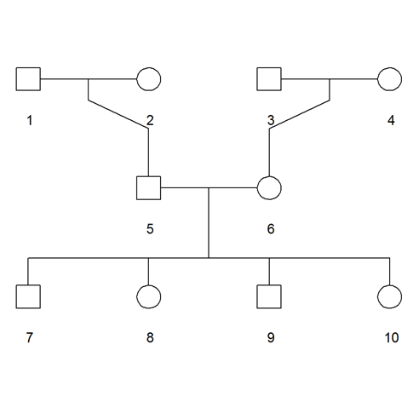
Simulation setting
Introduction
An overview of rare-variant analysis
Family-based rare-variant association test
Family-based rare-variant association test for X-linked genes
Summary and Conclusion
Method
Simulation study
Application to schizophrenia data
Discussion
Setting
0 < maf < 0.01
h² = 0.05
Extended family (10 components)
# of family = 50 and 100
Method : PedCMC, FPCA, RV-TDT,
FARVAT_{b} , FARVAT_{c} , FARVAT_{o}
β(+) vs β(-): 50%vs50%, 60%vs40%, 80%vs20%, 100%vs0%
Replicate = 50,000(type1 error), 5,000(power)
Simulation scenarios
Simulated data under the absence of population substructure
# of rare variants in a gene: 30, 100
In the 30 kb genetic region
Simulated data under the presence of population substructure
F_{ST} = 0, 0.005, 0.01, 0.05

Slide 23
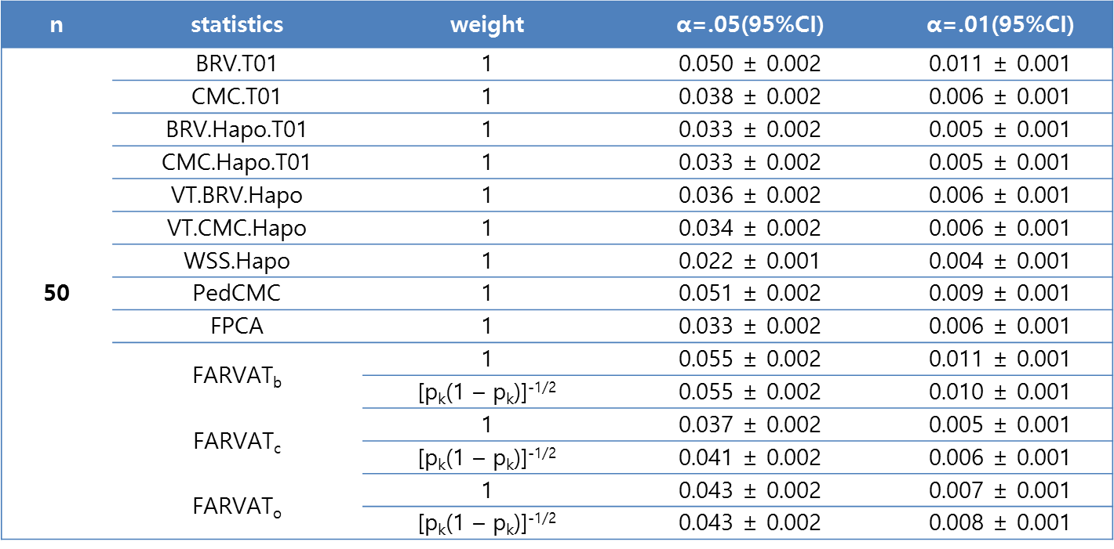
Evaluation with simulated data under the absence of population substructure
Introduction
An overview of rare-variant analysis
Family-based rare-variant association test
Family-based rare-variant association test for X-linked genes
Summary and Conclusion
Method
Simulation study
Application to schizophrenia data
Discussion
Table 3.1 Empirical type-1 error estimates for 30 rare variants.
conservative

Slide 24
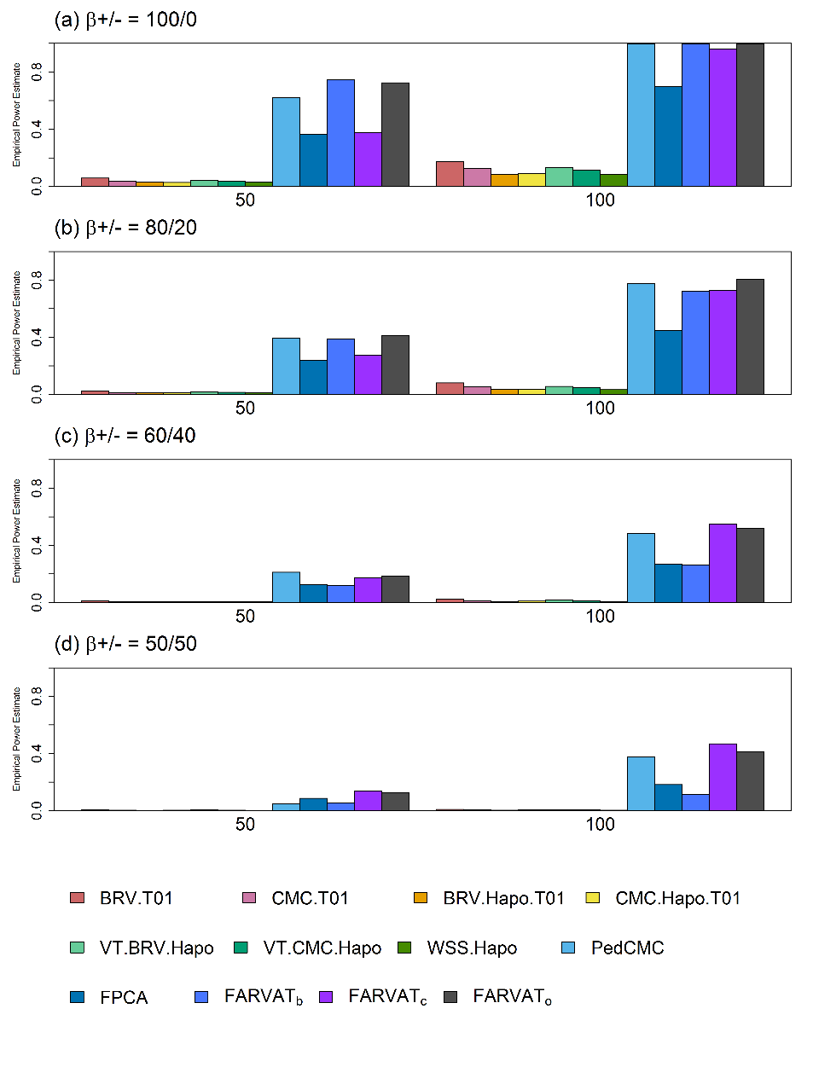

Evaluation with simulated data under the absence of population substructure
Introduction
An overview of rare-variant analysis
Family-based rare-variant association test
Family-based rare-variant association test for X-linked genes
Summary and Conclusion
Method
Simulation study
Application to schizophrenia data
Discussion
Figure 3.2 Empirical power estimates
when the number of rare variants in a gene is 30.

Slide 25
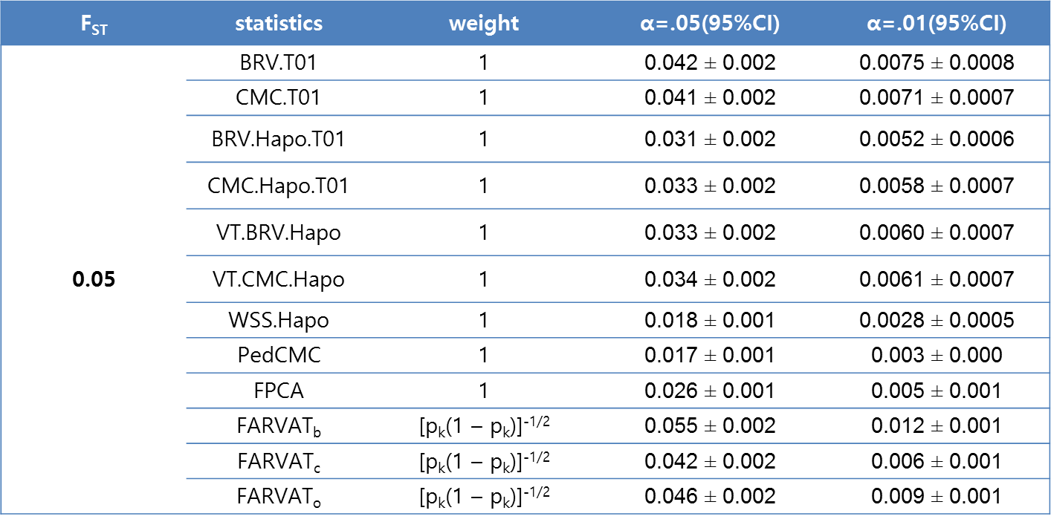
Evaluation with simulated data under the presence of population substructure
Introduction
An overview of rare-variant analysis
Family-based rare-variant association test
Family-based rare-variant association test for X-linked genes
Summary and Conclusion
Method
Simulation study
Application to schizophrenia data
Discussion
Table 3.4 Empirical type-1 error estimates under the presence of population substructure.
conservative

Slide 26
Evaluation with simulated data under the presence of population substructure
Introduction
An overview of rare-variant analysis
Family-based rare-variant association test
Family-based rare-variant association test for X-linked genes
Summary and Conclusion
Method
Simulation study
Application to schizophrenia data
Discussion
Figure 3.5 Empirical power estimates under the presence of
population substructure.

Slide 27
Application to schizophrenia data
Introduction
An overview of rare-variant analysis
Family-based rare-variant association test
Family-based rare-variant association test for X-linked genes
Summary and Conclusion
Method
Simulation study
Application to schizophrenia data
Discussion
Data Description
108 German samples (36 pedigrees)
Mendelian error 1 pedigree (sbn-235)
After filtering, 105 samples (35 pedigrees)
Prevalence of schizophrenia : 0.0063
31,046 Rare SNPs (CHR1~22)
# of genes (annotation using SnpEff soft)
High : 1,805
MOD : 11,248
LOW : 166

Slide 28
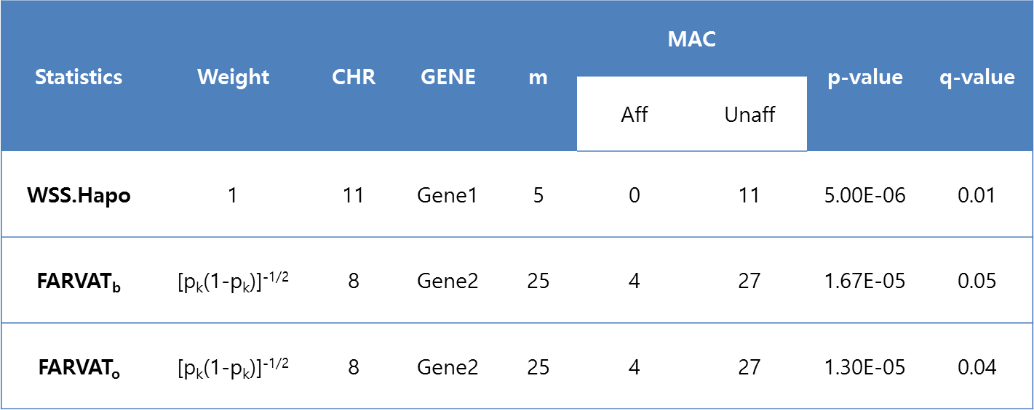
Application to schizophrenia data
Introduction
An overview of rare-variant analysis
Family-based rare-variant association test
Family-based rare-variant association test for X-linked genes
Summary and Conclusion
Method
Simulation study
Application to schizophrenia data
Discussion
Table 3.7 Significant results from the rare variant association analysis with schizophrenia data.

Slide 29
Discussion
Introduction
An overview of rare-variant analysis
Family-based rare-variant association test
Family-based rare-variant association test for X-linked genes
Summary and Conclusion
Method
Simulation study
Application to schizophrenia data
Discussion
In this chapter, we proposed burden-type, C-alpha-type and SKAT-O-type statistics for the association analysis of rare variants for binary traits with extended families.
With extensive simulations, FARVAT_{o} seemed to be a robust choice for the analysis of rare variants in extended families.
Furthermore the proposed method enables the analysis of rare variants within extended families, and its application to extended families may provide a breakthrough for the success of genetic association analysis.
This chapter was published in Bioinformatics.
Choi, Sungkyoung, et al. FARVAT: a family-based rare variant association test. Bioinformatics, (2014)

Slide 30
amily-based rare-variant association test for X-linked genes
F
Methods
Notations
X-linked rare variant association tests
Simulation study
The simulation setting
Evaluation with simulated data
Application to chronic obstructive pulmonary disease data
Discussion

Slide 31
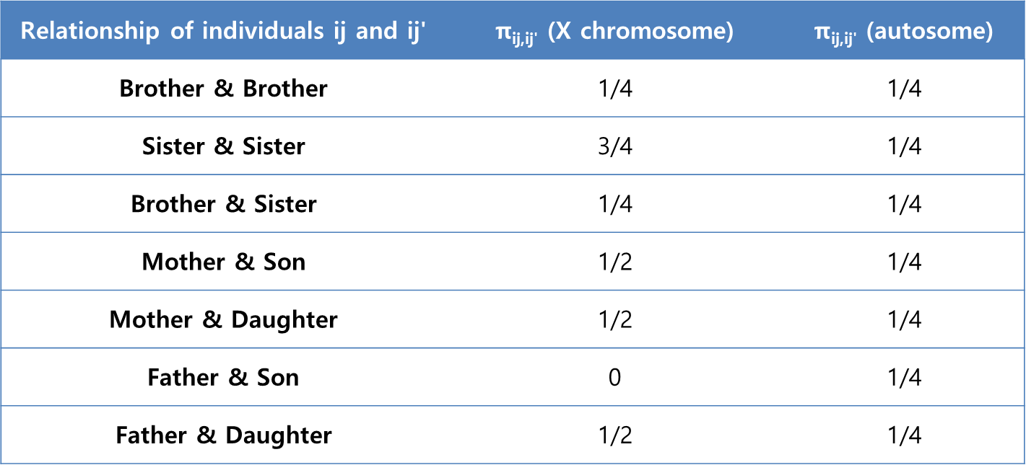
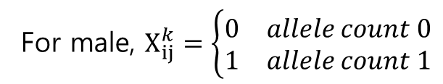
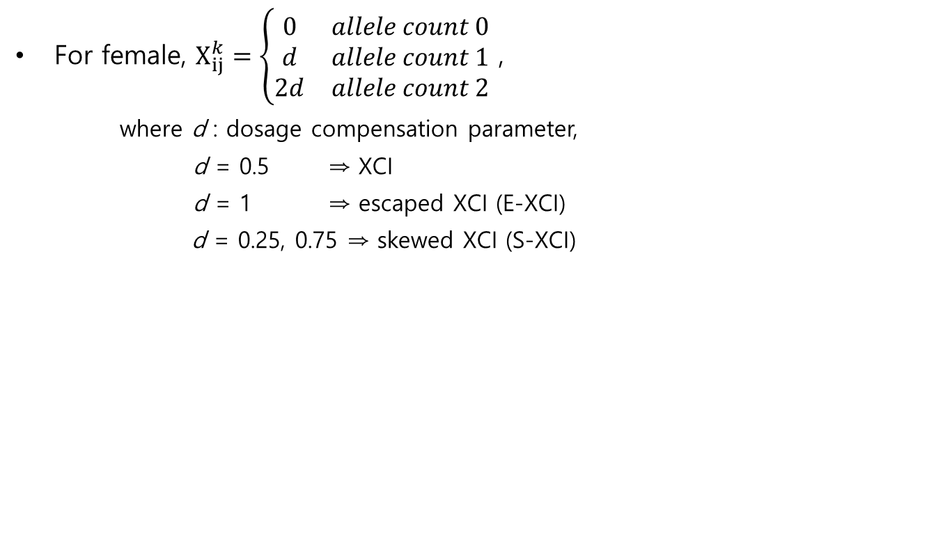
Notation
Introduction
An overview of rare-variant analysis
Family-based rare-variant association test
Family-based rare-variant association test for X-linked genes
Summary and Conclusion
Method
Simulation study
Application to chronic obstructive pulmonary disease data
Discussion
For female, $X_{ij}^{k}=\left\{\begin{matrix}0 & allele count 0 \\ d & allele count 1 \\ 2d & allele count 2\end{matrix}\right.$ ,
where d : dosage compensation parameter,
d = 0.5 ⇒ XCI
d = 1 ⇒ escaped XCI (E-XCI)
d = 0.25, 0.75 ⇒ skewed XCI (S-XCI)
For male, $X_{ij}^{k}=\left\{\begin{matrix}0 & allele count 0 \\ 1 & allele count 1\end{matrix}\right.$
Table 4.1 X chromosomal and autosomal kinship coefficients
for two individuals in a nuclear family.

Slide 32
Rare X-linked variant association tests
Introduction
An overview of rare-variant analysis
Family-based rare-variant association test
Family-based rare-variant association test for X-linked genes
Summary and Conclusion
Method
Simulation study
Application to schizophrenia data
Discussion
Quasi likelihood score
If we let
We can show that
where , and thus we have

Slide 33
Rare X-linked variant association tests
Introduction
An overview of rare-variant analysis
Family-based rare-variant association test
Family-based rare-variant association test for X-linked genes
Summary and Conclusion
Method
Simulation study
Application to schizophrenia data
Discussion
Test statistic
FARVAT-XB
FARVAT-XC
FARVAT-XO
where

Slide 34
Rare X-linked variant association tests
Introduction
An overview of rare-variant analysis
Family-based rare-variant association test
Family-based rare-variant association test for X-linked genes
Summary and Conclusion
Method
Simulation study
Application to schizophrenia data
Discussion
When the biological gene expression processes of X-linked genes are not clear, the proposed statistics may be sensitive to the choice of d.
We calculate FARVAT-XB or FARVAT-XC for various choices of d, and then combine them to a single p-value by using extended Fisher’s method for correlated p-values (Brown method).
We denote its p-value by FARVAT-XD where 0, 0.05, 0.1, …, 0.95, and 1 were considered for d₁, …, and d_{L}.

Slide 35
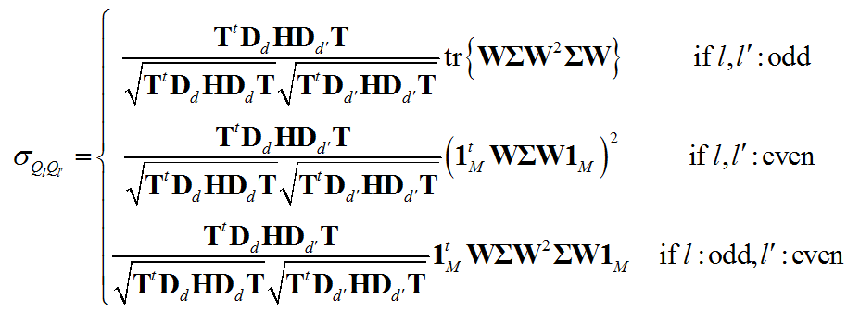
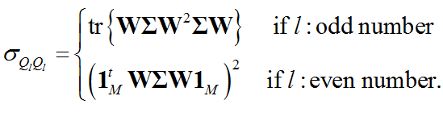
Rare X-linked variant association tests
Introduction
An overview of rare-variant analysis
Family-based rare-variant association test
Family-based rare-variant association test for X-linked genes
Summary and Conclusion
Method
Simulation study
Application to schizophrenia data
Discussion
If we let , the rare variant tests for burden-type and SKAT-type are denoted by
The covariance forms become
and the variance form are

Slide 36
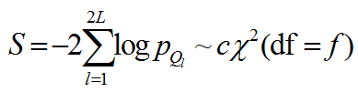
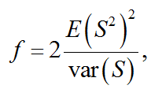
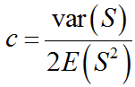
Rare X-linked variant association tests
Introduction
An overview of rare-variant analysis
Family-based rare-variant association test
Family-based rare-variant association test for X-linked genes
Summary and Conclusion
Method
Simulation study
Application to schizophrenia data
Discussion
Under the null hypothesis, S is equal to the scaled chi-square distribution as follows (Brown’s method):
Here c and f can be derived as
where

Slide 37
Simulation setting
Introduction
An overview of rare-variant analysis
Family-based rare-variant association test
Family-based rare-variant association test for X-linked genes
Summary and Conclusion
Method
Simulation study
Application to chronic obstructive pulmonary disease data
Discussion
Setting
# of variant : 30
# of family size : 200
β(+) vs β(-): 50%vs50%, 60%vs40%, 80%vs20%, 100%vs0%
Heritability(h²) : 0.01
Biological model: XCI, E-XCI, S-XCI to normal or deleterious allele
Methods : PedGene-Burden, PedGene-Kernel,
FARVAT-XB , FARVAT-XC , FARVAT-XO, and FARVAT-XD
Replicate = 5,000

Slide 38
Simulation setting
Introduction
An overview of rare-variant analysis
Family-based rare-variant association test
Family-based rare-variant association test for X-linked genes
Summary and Conclusion
Method
Simulation study
Application to chronic obstructive pulmonary disease data
Discussion
Simulation scenarios
Simulated data under the absence of population substructure
Prevalence Assumptions:
For males and females, male = female = 0.12
For males and females, male = 0.12, female= 0.36
male = 0.36, female= 0.12
Simulated data under the presence of population substructure
F_{ST} = 0, 0.005, 0.01, 0.05
Evaluation of robustness against biological expression process

Slide 39
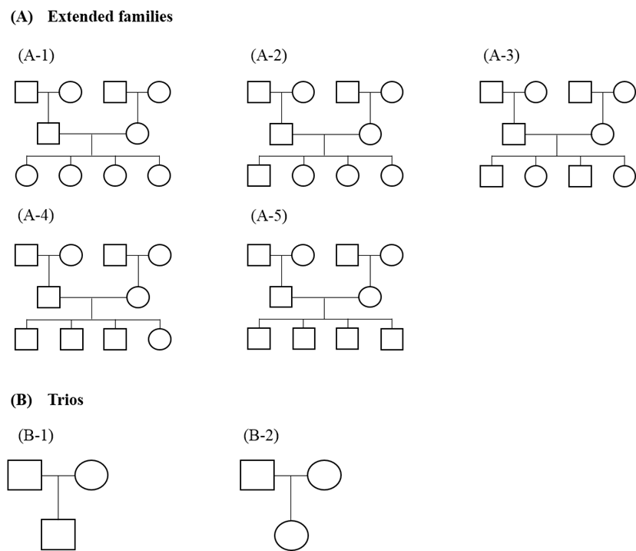
Simulation setting
Introduction
An overview of rare-variant analysis
Family-based rare-variant association test
Family-based rare-variant association test for X-linked genes
Summary and Conclusion
Method
Simulation study
Application to chronic obstructive pulmonary disease data
Discussion
Figure 4.1 Family structures considered in our simulation studies

Slide 40
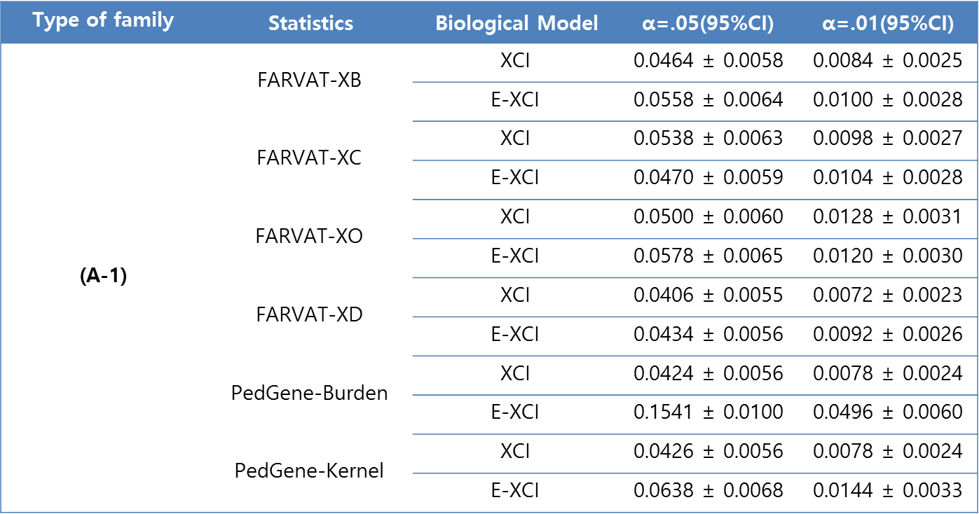
Evaluation with simulated data
Introduction
An overview of rare-variant analysis
Family-based rare-variant association test
Family-based rare-variant association test for X-linked genes
Summary and Conclusion
Method
Simulation study
Application to chronic obstructive pulmonary disease data
Discussion
Table 4.2 Empirical type-1 error estimates for XCI or E-XCI.
violated

Slide 41
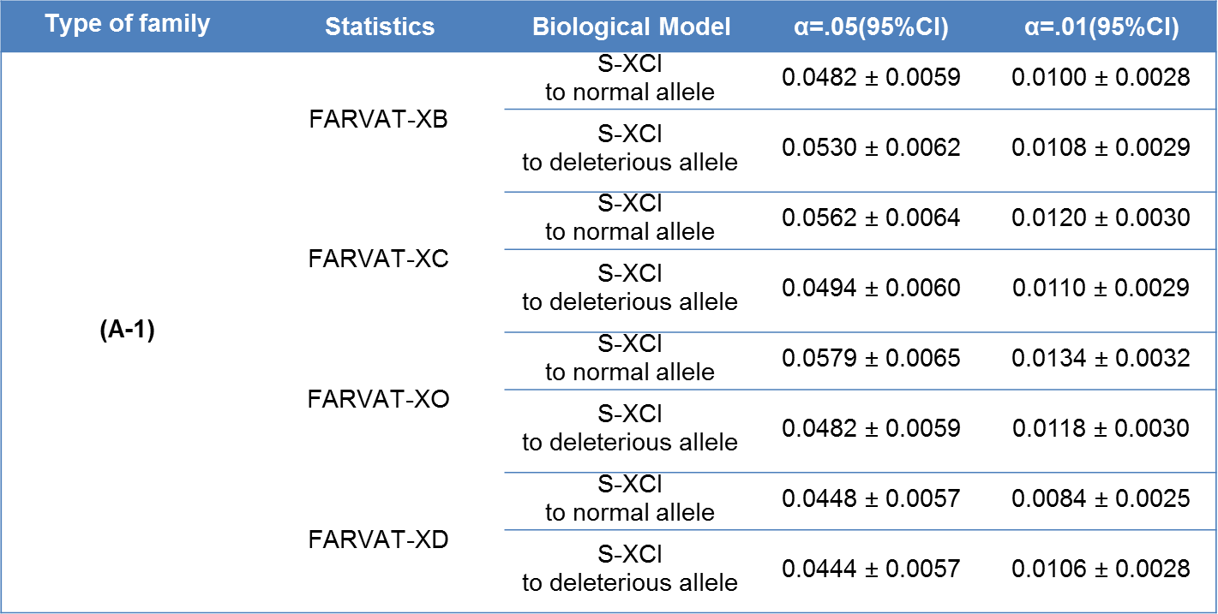
Evaluation with simulated data
Introduction
An overview of rare-variant analysis
Family-based rare-variant association test
Family-based rare-variant association test for X-linked genes
Summary and Conclusion
Method
Simulation study
Application to chronic obstructive pulmonary disease data
Discussion
Table 4.3 Empirical type-1 error estimates for S-XCI

Slide 42
Evaluation with simulated data
Introduction
An overview of rare-variant analysis
Family-based rare-variant association test
Family-based rare-variant association test for X-linked genes
Summary and Conclusion
Method
Simulation study
Application to chronic obstructive pulmonary disease data
Discussion
Figure 4.2 Empirical power estimates for random XCI

Slide 43
Evaluation with simulated data
Introduction
An overview of rare-variant analysis
Family-based rare-variant association test
Family-based rare-variant association test for X-linked genes
Summary and Conclusion
Method
Simulation study
Application to chronic obstructive pulmonary disease data
Discussion
Figure 4.3 Empirical power estimates for S-XCI to normal allele.

Slide 44
Evaluation with simulated data
Introduction
An overview of rare-variant analysis
Family-based rare-variant association test
Family-based rare-variant association test for X-linked genes
Summary and Conclusion
Method
Simulation study
Application to chronic obstructive pulmonary disease data
Discussion
Figure 4.4 Empirical power estimates for S-XCI to deleterious allele.

Slide 45
Evaluation with simulated data
Introduction
An overview of rare-variant analysis
Family-based rare-variant association test
Family-based rare-variant association test for X-linked genes
Summary and Conclusion
Method
Simulation study
Application to chronic obstructive pulmonary disease data
Discussion
Figure 4.5 Empirical power estimates for E-XCI.

Slide 46
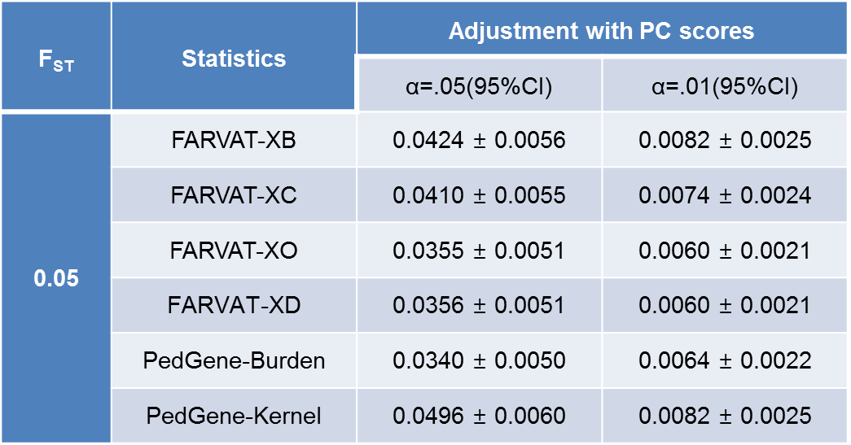
Evaluation with simulated data in the presence of population substructure
Introduction
An overview of rare-variant analysis
Family-based rare-variant association test
Family-based rare-variant association test for X-linked genes
Summary and Conclusion
Method
Simulation study
Application to chronic obstructive pulmonary disease data
Discussion
Table 4.8 Empirical type-1 error estimates for random XCI in the presence of population substructure.

Slide 47
Evaluation with simulated data in the presence of population substructure
Introduction
An overview of rare-variant analysis
Family-based rare-variant association test
Family-based rare-variant association test for X-linked genes
Summary and Conclusion
Method
Simulation study
Application to chronic obstructive pulmonary disease data
Discussion
Figure 4.6 Empirical power estimates for random XCI in the presence of population substructure.

Slide 48
Evaluation of robustness against biological expression process
Introduction
An overview of rare-variant analysis
Family-based rare-variant association test
Family-based rare-variant association test for X-linked genes
Summary and Conclusion
Method
Simulation study
Application to chronic obstructive pulmonary disease data
Discussion
Figure 4.7 Empirical power estimates when the gene expression processes of X-linked variants are misspecified.

Slide 49
Application to chronic obstructive pulmonary disease data (COPD)
Introduction
An overview of rare-variant analysis
Family-based rare-variant association test
Family-based rare-variant association test for X-linked genes
Summary and Conclusion
Method
Simulation study
Application to chronic obstructive pulmonary disease data
Discussion
Data Description
# of individuals
64 unaffected males, 83 unaffected females
55 affected males, and 100 affected females
# of pedigrees: 49 families
629 rare variants in 183 genes on the X chromosome
our analyses of the exclusion criteria
7 genes in pseudo-autosomal regions (PARs)
186 genes with a single rare variant

Slide 50
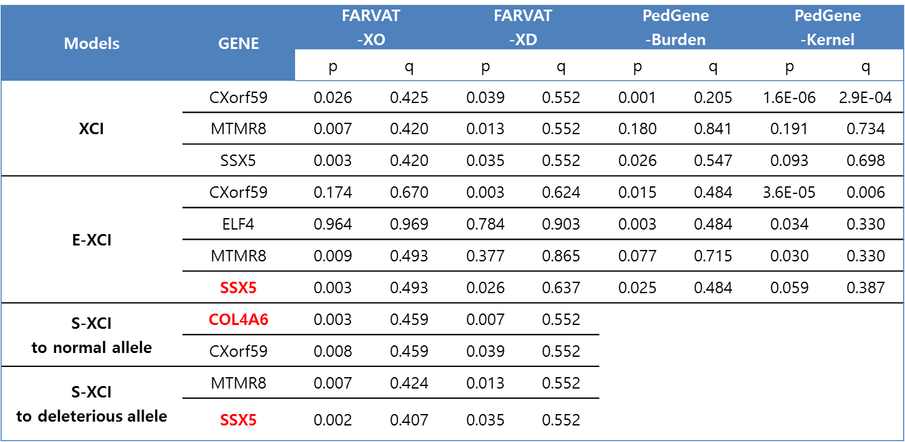
Application to chronic obstructive pulmonary disease data (COPD)
Introduction
An overview of rare-variant analysis
Family-based rare-variant association test
Family-based rare-variant association test for X-linked genes
Summary and Conclusion
Method
Simulation study
Application to chronic obstructive pulmonary disease data
Discussion
Table 4.10 Most significant results from rare variant association analyses of COPD data.

Slide 51
Discussion
Introduction
An overview of rare-variant analysis
Family-based rare-variant association test
Family-based rare-variant association test for X-linked genes
Summary and Conclusion
Method
Simulation study
Application to chronic obstructive pulmonary disease data
Discussion
In this chapter, we proposed a novel method for family-based association test of X-linked genes (FARVATX ), which can accommodate random XCI, E-XCI, and S-XCI.
The results from the simulation studies showed that PedGene-Burden and PedGene-Kernel statistics suffer from inflation of the type 1 error rate if the proportions of males and females are different or population substructure is present.
However, FARVATX preserves the nominal significance level in both the absence and presence of population substructure.

Slide 52
Discussion
Introduction
An overview of rare-variant analysis
Family-based rare-variant association test
Family-based rare-variant association test for X-linked genes
Summary and Conclusion
Method
Simulation study
Application to chronic obstructive pulmonary disease data
Discussion
Despite the analytical flexibility of the proposed methods, there are still some limitations.
The proposed methods are slightly conservative.
The statistical power depends on the definition of rare variants, but it is still unclear.
Third, the proposed methods assume that MAFs are same for males and females.
The proposed methods may help us identify additional rare X-linked variants associated with complex traits, thereby leading to about a better understanding of the underlying biological processes associated with X-linked genes.
This chapter was accepted in Genetic Epidemiology

Slide 53
ummary and Conclusion
S

Slide 54
Summary and Conclusion
Introduction
An overview of rare-variant analysis
Family-based rare-variant association test
Family-based rare-variant association test for X-linked genes
Summary and Conclusion
The rare variant analysis with family members can lead to identification of rare variants that are more causal. This is because family members are genetically more homogeneous than unrelated samples.
Therefore, family-based rare-variant association analysis seems to be both an efficient and cost-effective strategy, and the development of statistical methods for family-based sequencing data is necessary.
We developed family-based rare-variant tests for autosomal and X chromosome genes and demonstrated good performance of the proposed methods in simulation studies and real data analyses.

Slide 55
THANK YOU

Slide 57
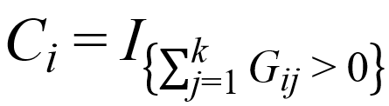
Burden-type methods
Introduction
An overview of rare-variant analysis
Family-based rare-variant association test
Family-based Rare Variant Association Test for X-linked genes
Summary and Conclusion
Challenges of rare-variant analysis
Review of rare-variants methods
Case-Control Design
CAST (Morgenthaler and Thilly 2007)
Genetic burden score
Pearson’s chi-square test
C_{i} |  | M₁ | M₂ | M₃ | M₄ | ID | Y
1 |  | 0 | 0 | 0 | 1 | 1 | Aff
1 |  | 0 | 1 | 2 | 0 | 2 | Un-aff
0 |  | 0 | 0 | 0 | 0 | 3 | Aff
 | C_{i} = 0 | C_{i} = 1
CASE | O₁₁ | O₁₂
CONT | O₂₁ | O₂₂

Slide 58
Burden-type methods
Introduction
An overview of rare-variant analysis
Family-based rare-variant association test
Family-based Rare Variant Association Test for X-linked genes
Summary and Conclusion
Challenges of rare-variant analysis
Review of rare-variants methods
Case-Control Design
CMC (Li and Leal 2008)
A combination of rare variants and common variants
MAF-based subgroups
Hotelling’s T²-test
where
M₁
M₃
M₅
C₁
C₂
C₃
M₂
M₄

Slide 59
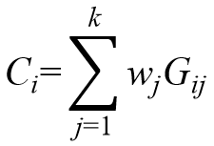
Burden-type methods
Introduction
An overview of rare-variant analysis
Family-based rare-variant association test
Family-based Rare Variant Association Test for X-linked genes
Summary and Conclusion
Challenges of rare-variant analysis
Review of rare-variants methods
Case-Control Design
WSS (Madsen and Browning 2009)
Assumes that rarer variants have stronger effects
Genetic burden score
where
Weighted sum test
The sum of the rank of the score: P-values by permutation

Slide 60
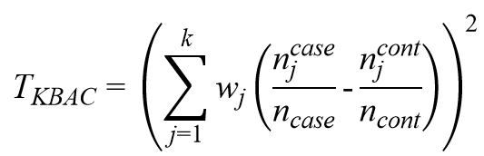
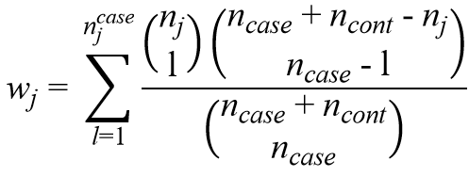
Burden-type methods
Introduction
An overview of rare-variant analysis
Family-based rare-variant association test
Family-based Rare Variant Association Test for X-linked genes
Summary and Conclusion
Challenges of rare-variant analysis
Review of rare-variants methods
Case-Control Design
KBAC (Liu and Leal 2010)
Test statistic
where the weight, w_{j} , is determined by a hyper-geometric kernel:
The p-value of KBAC is calculated by a permutation method.

Slide 61
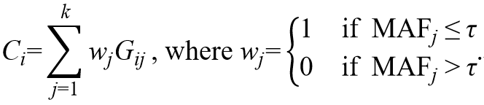
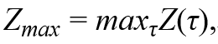
Burden-type methods
Introduction
An overview of rare-variant analysis
Family-based rare-variant association test
Family-based Rare Variant Association Test for X-linked genes
Summary and Conclusion
Challenges of rare-variant analysis
Review of rare-variants methods
Case-Control Design
VT (Price, et al. 2010)
Genetic burden score
where τ is a threshold
Test statistic
where Z(τ) is a z-score of C_{i}
P-value by permutation

Slide 62
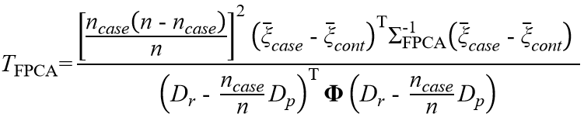
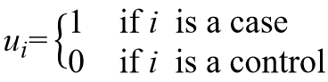
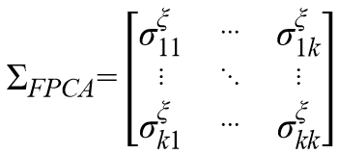
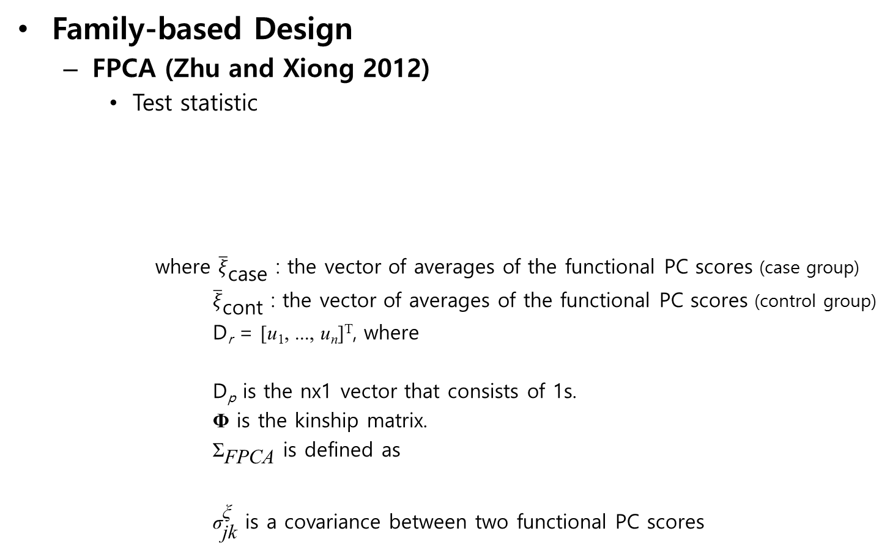
Burden-type methods
Introduction
An overview of rare-variant analysis
Family-based rare-variant association test
Family-based Rare Variant Association Test for X-linked genes
Summary and Conclusion
Challenges of rare-variant analysis
Review of rare-variants methods
Family-based Design
FPCA (Zhu and Xiong 2012)
Test statistic
where ${\overline{ξ}}_{\text{case}}$ : the vector of averages of the functional PC scores (case group)
${\overline{ξ}}_{\text{cont}}$ : the vector of averages of the functional PC scores (control group)
D_{r} = [u₁, ..., u_{n}]^{T}, where
D_{p} is the nx1 vector that consists of 1s.
$\text{Φ}$ is the kinship matrix.
${\text{Σ}}_{\text{FPCA}}$ is defined as
${\text{σ}}_{\text{jk}}^{\text{ξ}}$ is a covariance between two functional PC scores

Slide 63
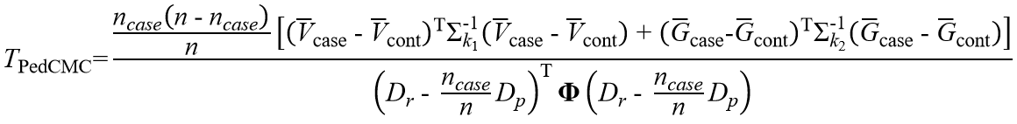
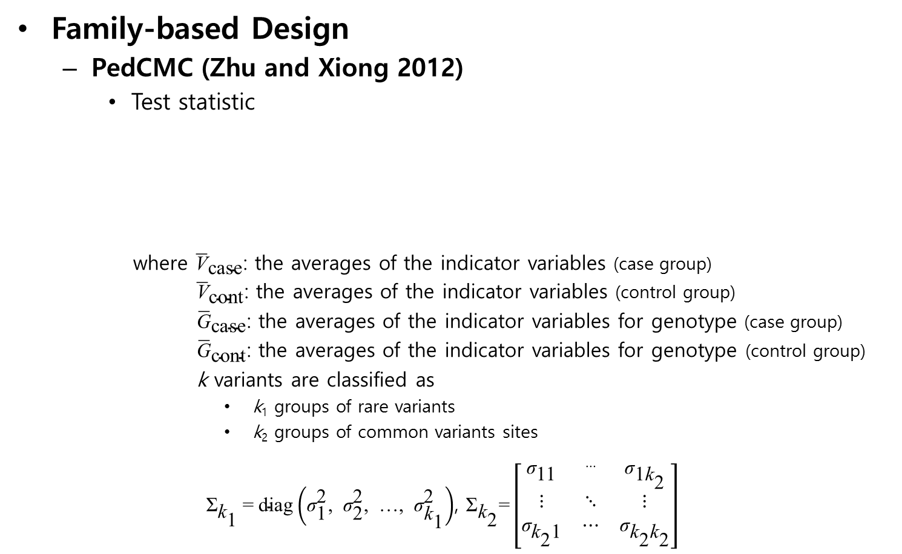
Burden-type methods
Introduction
An overview of rare-variant analysis
Family-based rare-variant association test
Family-based Rare Variant Association Test for X-linked genes
Summary and Conclusion
Challenges of rare-variant analysis
Review of rare-variants methods
Family-based Design
PedCMC (Zhu and Xiong 2012)
Test statistic
where ${\overline{\text{V}}}_{\text{case}}$: the averages of the indicator variables (case group)
${\overline{\text{V}}}_{\text{cont}}$: the averages of the indicator variables (control group)
${\overline{\text{G}}}_{\text{case}}$: the averages of the indicator variables for genotype (case group)
${\overline{\text{G}}}_{\text{cont}}$: the averages of the indicator variables for genotype (control group)
k variants are classified as
k₁ groups of rare variants
k₂ groups of common variants sites
${\text{Σ}}_{{\text{k}}_{\text{1}}} \text{=} \text{diag}\left({\text{σ}}_{\text{1}}^{\text{2}}\text{, }{\text{σ}}_{\text{2}}^{\text{2}}\text{, …, }{\text{σ}}_{{\text{k}}_{\text{1}}}^{\text{2}}\right)$, ${\text{Σ}}_{{\text{k}}_{\text{2}}}\text{=}\left[\begin{matrix}{\text{σ}}_{\text{11}} & \text{⋯} & {\text{σ}}_{{\text{1}\text{k}}_{\text{2}}} \\ \text{⋮} & \text{⋱} & \text{⋮} \\ {\text{σ}}_{{\text{k}}_{\text{2}}\text{1}} & \text{⋯} & {\text{σ}}_{{\text{k}}_{\text{2}}{\text{k}}_{\text{2}}}\end{matrix}\right]$

Slide 64
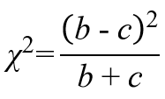
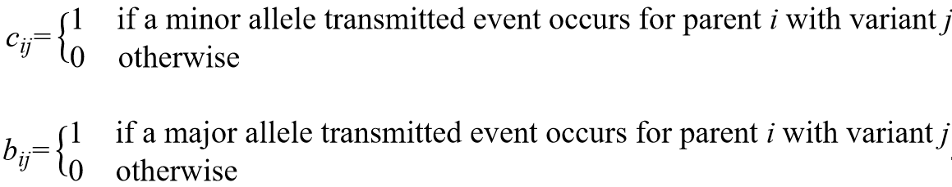
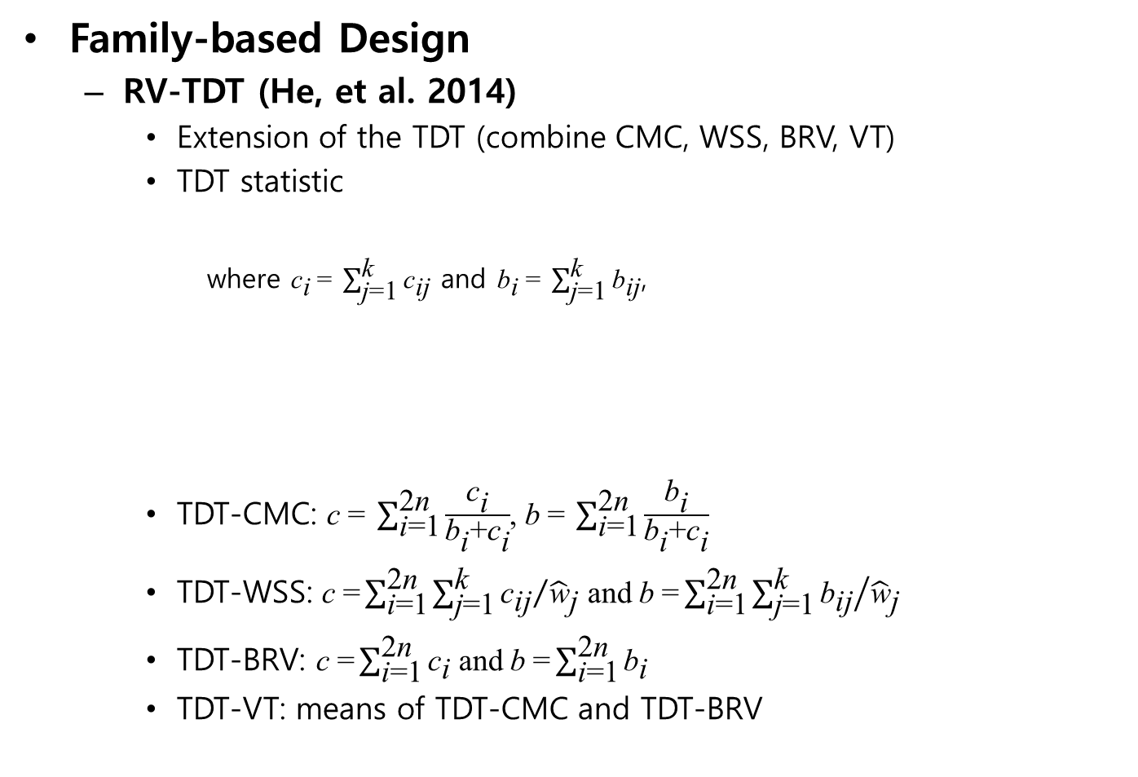
Burden-type methods
Introduction
An overview of rare-variant analysis
Family-based rare-variant association test
Family-based Rare Variant Association Test for X-linked genes
Summary and Conclusion
Challenges of rare-variant analysis
Review of rare-variants methods
Family-based Design
RV-TDT (He, et al. 2014)
Extension of the TDT (combine CMC, WSS, BRV, VT)
TDT statistic
where ${\text{c}}_{\text{i}} \text{=} \sum_{\text{j}\text{=1}}^{\text{k}}{{\text{c}}_{\text{ij}}}$ and ${\text{b}}_{\text{i}} \text{=} \sum_{\text{j}\text{=1}}^{\text{k}}{{\text{b}}_{\text{ij}}}$,
TDT-CMC: c $\text{=} \sum_{\text{i}\text{=1}}^{\text{2}\text{n}}{\frac{{\text{c}}_{\text{i}}}{{\text{b}}_{\text{i}}\text{+}{\text{c}}_{\text{i}}}}$, b $\text{=} \sum_{\text{i}\text{=1}}^{\text{2}\text{n}}{\frac{{\text{b}}_{\text{i}}}{{\text{b}}_{\text{i}}\text{+}{\text{c}}_{\text{i}}}}$
TDT-WSS: c $\text{=}\sum_{\text{i}\text{=1}}^{\text{2}\text{n}}{\sum_{\text{j}\text{=1}}^{\text{k}}{{{\text{c}}_{\text{ij}}}/{{\hat{\text{w}}}_{\text{j}}}}}$ and b $\text{=}\sum_{\text{i}\text{=1}}^{\text{2}\text{n}}{\sum_{\text{j}\text{=1}}^{\text{k}}{{{\text{b}}_{\text{ij}}}/{{\hat{\text{w}}}_{\text{j}}}}}$
TDT-BRV: c $\text{=}\sum_{\text{i}\text{=1}}^{\text{2}\text{n}}{{\text{c}}_{\text{i}}}$ and b $\text{=}\sum_{\text{i}\text{=1}}^{\text{2}\text{n}}{{\text{b}}_{\text{i}}}$
TDT-VT: means of TDT-CMC and TDT-BRV

Slide 66
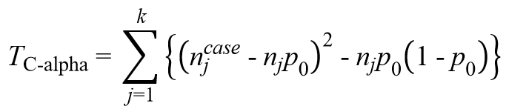
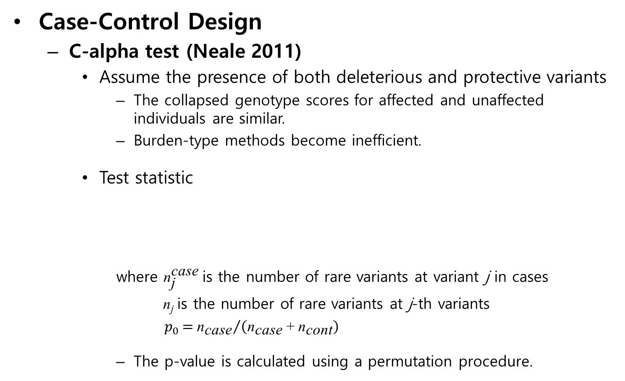
Variance component-type methods
Introduction
An overview of rare-variant analysis
Family-based rare-variant association test
Family-based Rare Variant Association Test for X-linked genes
Summary and Conclusion
Challenges of rare-variant analysis
Review of rare-variants methods
Case-Control Design
C-alpha test (Neale 2011)
Assume the presence of both deleterious and protective variants
The collapsed genotype scores for affected and unaffected individuals are similar.
Burden-type methods become inefficient.
Test statistic
where ${\text{n}}_{\text{j}}^{\text{case}}$ is the number of rare variants at variant j in cases
n_{j} is the number of rare variants at j-th variants
$p_{0}{{\text{= }\text{n}}_{\text{case}}}/{\left({\text{n}}_{\text{case}} \text{+} {\text{n}}_{\text{cont}}\right)}$
The p-value is calculated using a permutation procedure.

Slide 67
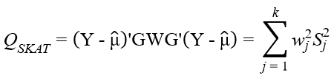
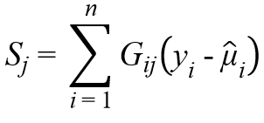
Variance component-type methods
Introduction
An overview of rare-variant analysis
Family-based rare-variant association test
Family-based Rare Variant Association Test for X-linked genes
Summary and Conclusion
Challenges of rare-variant analysis
Review of rare-variants methods
Case-Control Design
SKAT (Wu, et al. 2011)
Model
Test statistic
where w_{j} =Beta(MAF_{j}, 1, 25) and S_{j} is a single variant score statistic
Q_{SKAT} asymptotically follows a mixture of chi-square distribution.

Slide 68
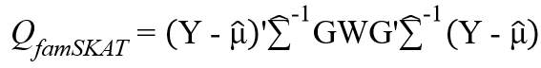
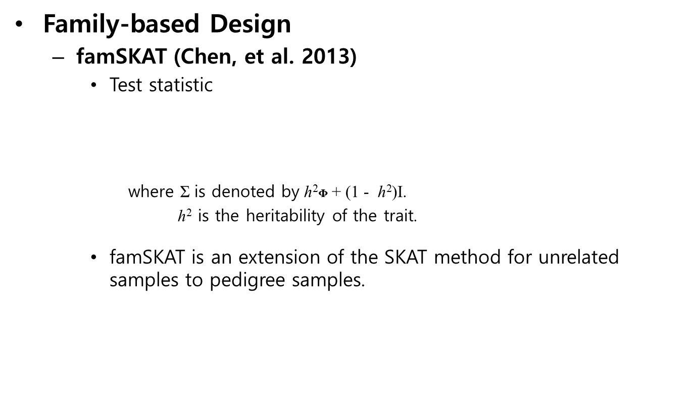
Variance component-type methods
Introduction
An overview of rare-variant analysis
Family-based rare-variant association test
Family-based Rare Variant Association Test for X-linked genes
Summary and Conclusion
Challenges of rare-variant analysis
Review of rare-variants methods
Family-based Design
famSKAT (Chen, et al. 2013)
Test statistic
where Σ is denoted by h²$\text{Φ}$ + (1 - h²)I.
h² is the heritability of the trait.
famSKAT is an extension of the SKAT method for unrelated samples to pedigree samples.

Slide 70
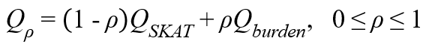
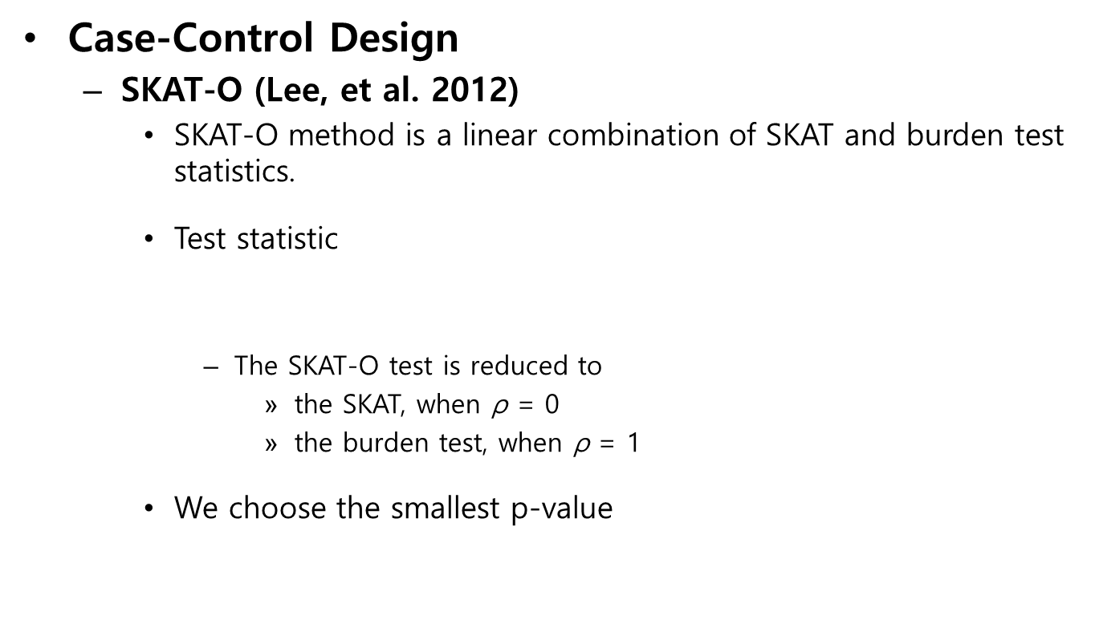
Optimal-type methods
Introduction
An overview of rare-variant analysis
Family-based rare-variant association test
Family-based Rare Variant Association Test for X-linked genes
Summary and Conclusion
Challenges of rare-variant analysis
Review of rare-variants methods
Case-Control Design
SKAT-O (Lee, et al. 2012)
SKAT-O method is a linear combination of SKAT and burden test statistics.
Test statistic
The SKAT-O test is reduced to
the SKAT, when $\text{ρ}$ = 0
the burden test, when $\text{ρ}$ = 1
We choose the smallest p-value

Slide 71
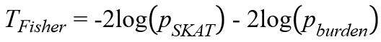
Optimal-type methods
Introduction
An overview of rare-variant analysis
Family-based rare-variant association test
Family-based Rare Variant Association Test for X-linked genes
Summary and Conclusion
Challenges of rare-variant analysis
Review of rare-variants methods
Case-Control Design
Fisher’s hybrid statistics (Derkach, et al. 2013)
To use Fisher’s method of combining p-values from SKAT and burden statistics
Test statistic
where p_{SKAT} is p-value obtained from SKAT
p_{burden} is p-value obtained from burden test

Slide 72
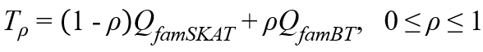
Optimal-type methods
Introduction
An overview of rare-variant analysis
Family-based rare-variant association test
Family-based Rare Variant Association Test for X-linked genes
Summary and Conclusion
Challenges of rare-variant analysis
Review of rare-variants methods
Family-based Design
MONSTER (Jiang and McPeek 2014)
MONSTER is an extension of SKAT-O method for unrelated samples to pedigree samples.
Test statistic
where Q_{famSKAT} is famSKAT test statistic (Chen, et al. 2013)
Q_{famBT} is famBT(burden type) test statistic (Chen, et al. 2013)
ρ parameter allows MONSTER to balance between two statistics in order to achieve robustness for a wide range of possible genetic architectures of the trait.

Slide 74
Evaluation with simulated data under the absence of population substructure
Introduction
An overview of rare-variant analysis
Family-based rare-variant association test
Family-based Rare Variant Association Test for X-linked genes
Summary and Conclusion
Method
Simulation study
Application to schizophrenia data
Discussion
Table 3.2 Empirical type-1 error estimates for 100 rare variants.
n | statistics | weight | α=.05(95%CI) | α=.01(95%CI)
50 | BRV.T01 | 1 | 0.060 ± 0.002 | 0.017 ± 0.0011
 | CMC.T01 | 1 | 0.020 ± 0.001 | 0.003 ± 0.0005
 | BRV.Hapo.T01 | 1 | 0.014 ± 0.001 | 0.002 ± 0.0004
 | CMC.Hapo.T01 | 1 | 0.010 ± 0.001 | 0.001 ± 0.0003
 | VT.BRV.Hapo | 1 | 0.019 ± 0.001 | 0.003 ± 0.0005
 | VT.CMC.Hapo | 1 | 0.012 ± 0.001 | 0.002 ± 0.0004
 | WSS.Hapo | 1 | 0.007 ± 0.001 | 0.001 ± 0.0003
 | PedCMC | 1 | 0.052 ± 0.002 | 0.010 ± 0.001
 | FPCA | 1 | 0.028 ± 0.001 | 0.005 ± 0.001
 | FARVAT_{b} | 1 | 0.053 ± 0.002 | 0.011 ± 0.001
 |  | [p_{k}(1 – p_{k})]^{-1/2} | 0.054 ± 0.002 | 0.011 ± 0.001
 | FARVAT_{c} | 1 | 0.032 ± 0.002 | 0.004 ± 0.001
 |  | [p_{k}(1 – p_{k})]^{-1/2} | 0.037 ± 0.002 | 0.006 ± 0.001
 | FARVAT_{o} | 1 | 0.042 ± 0.002 | 0.007 ± 0.001
 |  | [p_{k}(1 – p_{k})]^{-1/2} | 0.040 ± 0.002 | 0.008 ± 0.001

Slide 75
Evaluation with simulated data under the absence of population substructure
Introduction
An overview of rare-variant analysis
Family-based rare-variant association test
Family-based Rare Variant Association Test for X-linked genes
Summary and Conclusion
Method
Simulation study
Application to schizophrenia data
Discussion
Table 3.3 Empirical type-1 error estimates in the 30 kb genetic region.
n | statistics | weight | α=.05(95%CI) | α=.01(95%CI)
50 | BRV.T01 | 1 | 0.102 ± 0.003 | 0.031±0.002
 | CMC.T01 | 1 | 0.071 ± 0.002 | 0.014 ± 0.001
 | BRV.Hapo.T01 | 1 | 0.045 ± 0.002 | 0.009 ± 0.001
 | CMC.Hapo.T01 | 1 | 0.043 ± 0.002 | 0.008 ± 0.001
 | VT.BRV.Hapo | 1 | 0.048 ± 0.002 | 0.009 ± 0.001
 | VT.CMC.Hapo | 1 | 0.045 ± 0.002 | 0.009 ± 0.001
 | WSS.Hapo | 1 | 0.025 ± 0.001 | 0.004 ± 0.001
 | PedCMC | 1 | 0.088 ± 0.002 | 0.021 ± 0.001
 | FPCA | 1 | 0.055 ± 0.002 | 0.012 ± 0.001
 | FARVAT_{b} | 1 | 0.052 ± 0.002 | 0.011 ± 0.001
 |  | [p_{k}(1 – p_{k})]^{-1/2} | 0.052 ± 0.002 | 0.010 ± 0.001
 | FARVAT_{c} | 1 | 0.046 ± 0.002 | 0.009 ± 0.001
 |  | [p_{k}(1 – p_{k})]^{-1/2} | 0.049 ± 0.002 | 0.011 ± 0.001
 | FARVAT_{o} | 1 | 0.056 ± 0.002 | 0.012 ± 0.001
 |  | [p_{k}(1 – p_{k})]^{-1/2} | 0.050 ± 0.002 | 0.011 ± 0.001

Slide 76
Evaluation with simulated data under the absence of population substructure
Introduction
An overview of rare-variant analysis
Family-based rare-variant association test
Family-based Rare Variant Association Test for X-linked genes
Summary and Conclusion
Method
Simulation study
Application to schizophrenia data
Discussion
Figure 3.3 Empirical power estimates when the number of rare variants in a gene is 100.

Slide 77
Evaluation with simulated data under the absence of population substructure
Introduction
An overview of rare-variant analysis
Family-based rare-variant association test
Family-based Rare Variant Association Test for X-linked genes
Summary and Conclusion
Method
Simulation study
Application to schizophrenia data
Discussion
Figure 3.4 Empirical power estimates when all rare variants in a gene are considered.

Slide 79
Evaluation with simulated data
Introduction
An overview of rare-variant analysis
Family-based rare-variant association test
Family-based Rare Variant Association Test for X-linked genes
Summary and Conclusion
Method
Simulation study
Application to chronic obstructive pulmonary disease data
Discussion
Table 4.4 Empirical type-1 error estimates for XCI or E-XCI when prevalence for males (0.36) and females (0.12) are different.
Type of family | Statistics | Biological Model | α=.05(95%CI) | α=.01(95%CI)
(A-1) | FARVAT-XB | XCI | 0.0486 ± 0.0060 | 0.0102 ± 0.0028
 |  | E-XCI | 0.0526 ± 0.0062 | 0.0142 ± 0.0033
 | FARVAT-XC | XCI | 0.0528 ± 0.0062 | 0.0132 ± 0.0032
 |  | E-XCI | 0.0486 ± 0.0060 | 0.0098 ± 0.0027
 | FARVAT-XO | XCI | 0.0469 ± 0.0059 | 0.0131 ± 0.0032
 |  | E-XCI | 0.0552 ± 0.0063 | 0.0123 ± 0.0031
 | FARVAT-XD | XCI | 0.0456 ± 0.0058 | 0.0130 ± 0.0031
 |  | E-XCI | 0.0460 ± 0.0058 | 0.0128 ± 0.0031
 | PedGene-Burden | XCI | 0.0492 ± 0.0060 | 0.0096 ± 0.0027
 |  | E-XCI | 0.6941 ± 0.0128 | 0.4477 ± 0.0138
 | PedGene-Kernel | XCI | 0.0468 ± 0.0059 | 0.0074 ± 0.0024
 |  | E-XCI | 0.1750 ± 0.0105 | 0.0572 ± 0.0064

Slide 80
Evaluation with simulated data
Introduction
An overview of rare-variant analysis
Family-based rare-variant association test
Family-based Rare Variant Association Test for X-linked genes
Summary and Conclusion
Method
Simulation study
Application to chronic obstructive pulmonary disease data
Discussion
Table 4.5 Empirical type-1 error estimates for S-XCI when prevalence for males (0.36) and females (0.12) are different.
Type of family | Statistics | Biological Model | α=.05(95%CI) | α=.01(95%CI)
(A-1) | FARVAT-XB | S-XCI to normal allele | 0.0548 ± 0.0063 | 0.0102 ± 0.0028
 |  | S-XCI to deleterious allele | 0.0506 ± 0.0061 | 0.0086 ± 0.0026
 | FARVAT-XC | S-XCI to normal allele | 0.0540 ± 0.0063 | 0.0116 ± 0.0030
 |  | S-XCI to deleterious allele | 0.0532 ± 0.0062 | 0.0122 ± 0.0030
 | FARVAT-XO | S-XCI to normal allele | 0.0560 ± 0.0064 | 0.0110 ± 0.0029
 |  | S-XCI to deleterious allele | 0.0477 ± 0.0059 | 0.0099 ± 0.0027
 | FARVAT-XD | S-XCI to normal allele | 0.0452 ± 0.0058 | 0.0106 ± 0.0028
 |  | S-XCI to deleterious allele | 0.0438 ± 0.0057 | 0.0110 ± 0.0029

Slide 81
Evaluation with simulated data
Introduction
An overview of rare-variant analysis
Family-based rare-variant association test
Family-based Rare Variant Association Test for X-linked genes
Summary and Conclusion
Method
Simulation study
Application to chronic obstructive pulmonary disease data
Discussion
Table 4.6 Empirical type-1 error estimates for XCI or E-XCI when prevalence for males (0.12) and females (0.36) are different.
Type of family | Statistics | Biological Model | α=.05(95%CI) | α=.01(95%CI)
(A-1) | FARVAT-XB | XCI | 0.0558 ± 0.0064 | 0.0094 ± 0.0027
 |  | E-XCI | 0.0560 ± 0.0064 | 0.0138 ± 0.0032
 | FARVAT-XC | XCI | 0.0518 ± 0.0061 | 0.0090 ± 0.0026
 |  | E-XCI | 0.0486 ± 0.0060 | 0.0086 ± 0.0026
 | FARVAT-XO | XCI | 0.0542 ± 0.0063 | 0.0092 ± 0.0027
 |  | E-XCI | 0.0501 ± 0.0060 | 0.0159 ± 0.0035
 | FARVAT-XD | XCI | 0.0426 ± 0.0056 | 0.0080 ± 0.0025
 |  | E-XCI | 0.0464 ± 0.0058 | 0.0100 ± 0.0028
 | PedGene-Burden | XCI | 0.0472 ± 0.0059 | 0.0106 ± 0.0028
 |  | E-XCI | 0.3075 ± 0.0128 | 0.1290 ± 0.0093
 | PedGene-Kernel | XCI | 0.0486 ± 0.0060 | 0.0090 ± 0.0026
 |  | E-XCI | 0.0806 ± 0.0075 | 0.0138 ± 0.0032

Slide 82
Evaluation with simulated data
Introduction
An overview of rare-variant analysis
Family-based rare-variant association test
Family-based Rare Variant Association Test for X-linked genes
Summary and Conclusion
Method
Simulation study
Application to chronic obstructive pulmonary disease data
Discussion
Table 4.7 Empirical type-1 error estimates for S-XCI when prevalence for males (0.12) and females (0.36) are different.
Type of family | Statistics | Biological Model | α=.05(95%CI) | α=.01(95%CI)
(A-1) | FARVAT-XB | S-XCI to normal allele | 0.0524 ± 0.0062 | 0.0118 ± 0.0030
 |  | S-XCI to deleterious allele | 0.0476 ± 0.0059 | 0.0092 ± 0.0026
 | FARVAT-XC | S-XCI to normal allele | 0.0494 ± 0.0060 | 0.0108 ± 0.0029
 |  | S-XCI to deleterious allele | 0.0498 ± 0.0060 | 0.0098 ± 0.0027
 | FARVAT-XO | S-XCI to normal allele | 0.0492 ± 0.0060 | 0.0123 ± 0.0031
 |  | S-XCI to deleterious allele | 0.0453 ± 0.0058 | 0.0087 ± 0.0026
 | FARVAT-XD | S-XCI to normal allele | 0.0456 ± 0.0058 | 0.0094 ± 0.0027
 |  | S-XCI to deleterious allele | 0.0424 ± 0.0056 | 0.0062 ± 0.0022

